Slide 1


Curated Courses in Mathematics
Petra Bonfert-Taylor, Sarah E. Eichhorn, David Farmer and Jim Fowler
Research in Improving Undergraduate Mathematical Sciences Education, JMM
January 12, 2018
Funded by NSF grant #1505246

Slide 2
Abstract: CuratedCourses in Mathematics is a project to create, gather, curate, tag, review, organize and make available high quality online open educational mathematics resources. The project aims to coordinate work being done at multiple institutions on similar courses, enabling faculty to share resources they create or curate from other sources. By creating a system for curating and tagging resources our hope is that faculty can more easily find high quality materials to utilize in their classes and more broadly disseminate good resources they create.
We will describe the project itself, describe resources we have created for faculty about how to design and produce online mathematics content, describe our tagging system for content submitted to our site as well as present our future goals for the project.
Notes:
Petra

Slide 3
Introduction to the CuratedCourses Project
Notes:
Petra

Slide 4

Curated Courses in Mathematics ( )
Project to:
Create and
Curate (gather, tag, organize, review, make available)
high quality online open educational mathematics resources.
Motivation?
“I’d like to explore active learning in my class. But it’s so much work to create all of the resources?”
“Did you do anything important in class today?”
“How can I help my students visualize the cross product?”
https://kclegacypress. com/archives/5215
http://neuralname.com/
https://en.wikipedia.org/wiki/Right-hand_rule
Notes:
Petra
Probably describe this as “the solution” to the “problem” stated on the previous slide. Clarify the extent to which this project is new or different from what’s already out there.
Clarify that we are curating the resources of others as well as ones we are developing.

Slide 5
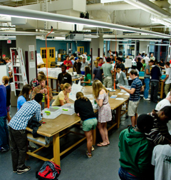
Active Learning
Rather than passively listening to information being transmitted: students learn through activities and/or discussions.
Large body of scientific evidence asserts:
Retention improves significantly if learning is active.
Active learning leads to significantly lower failure rates in STEM classes.
Notes:
Petra
Presumably the speaker will make clear that this is just the context for what we are doing, not the main focus.
Do we want to add an outline of the talk before this? Or maybe just stick the abstract on a new slide after the title slide?

Slide 6


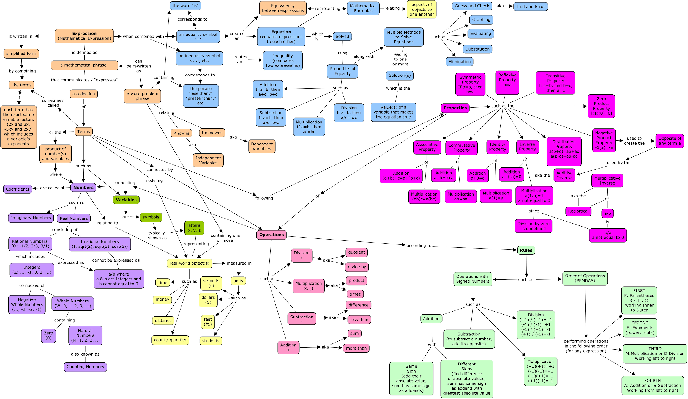
Sample Activities
Small group discussion
Peer instruction
Clickers
Problem-based learning
Group tests
Concept mapping
...
Notes:
Petra

Slide 7
Difficulty
Creating educational mathematics resources is time-consuming.
Videos
Online quizzes
In-class activities
Simulations
…
Additional time has to be spent to decide on
best tools
best practices
Sharing such resources is currently not the norm.
Many great resources are "stuck" in LMS's or other password-protected sites.
Notes:
Petra

Slide 8
Solution: CuratedCourses in Mathematics!
Current focus: Linear Algebra
Types of resources we curate:
Video
Worksheets
Quizzes
Lesson plans
Clicker questions
Etc.
Website: https://curatedcourses.org/
https://en.wikipedia.org/wiki/File:Linear_subspaces_with_shading.svg
Notes:
Petra
Already lots of resources on Calculus available, none for linear algebra; lots of different versions of linear algebra

Slide 9
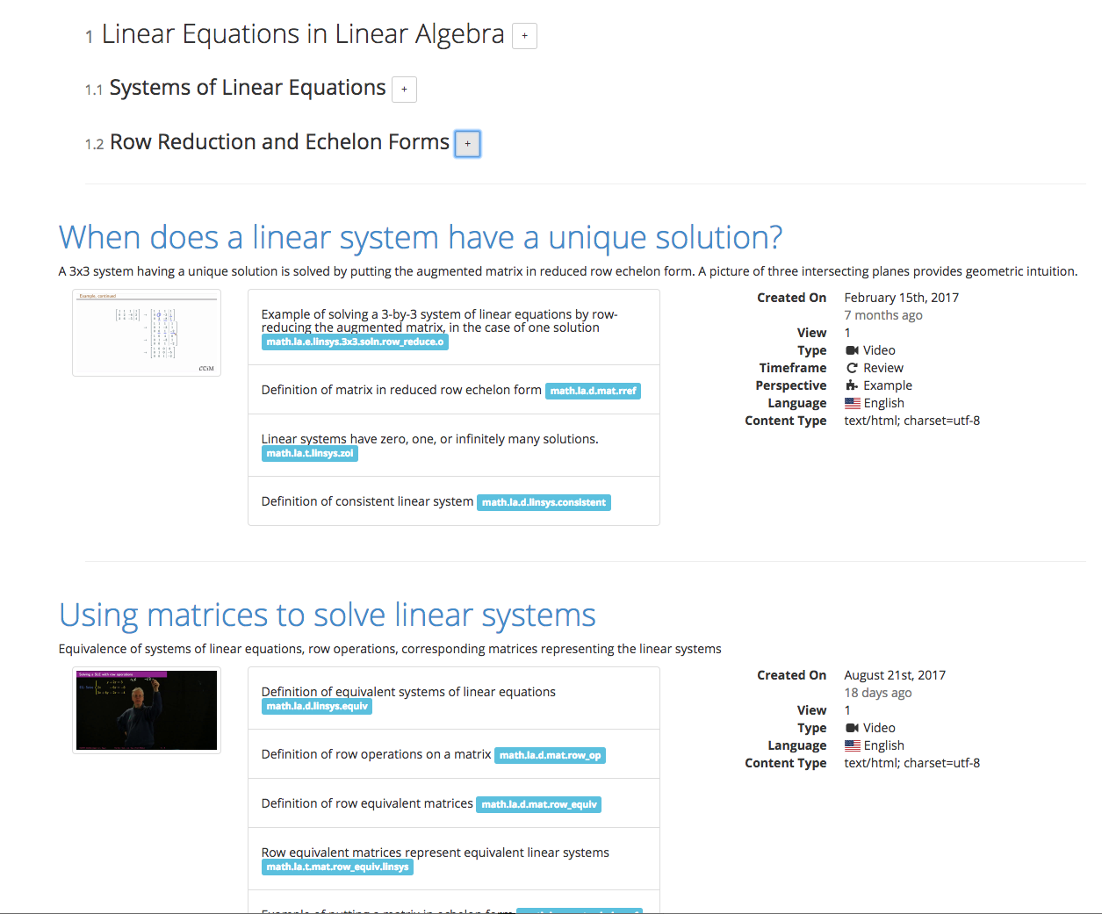
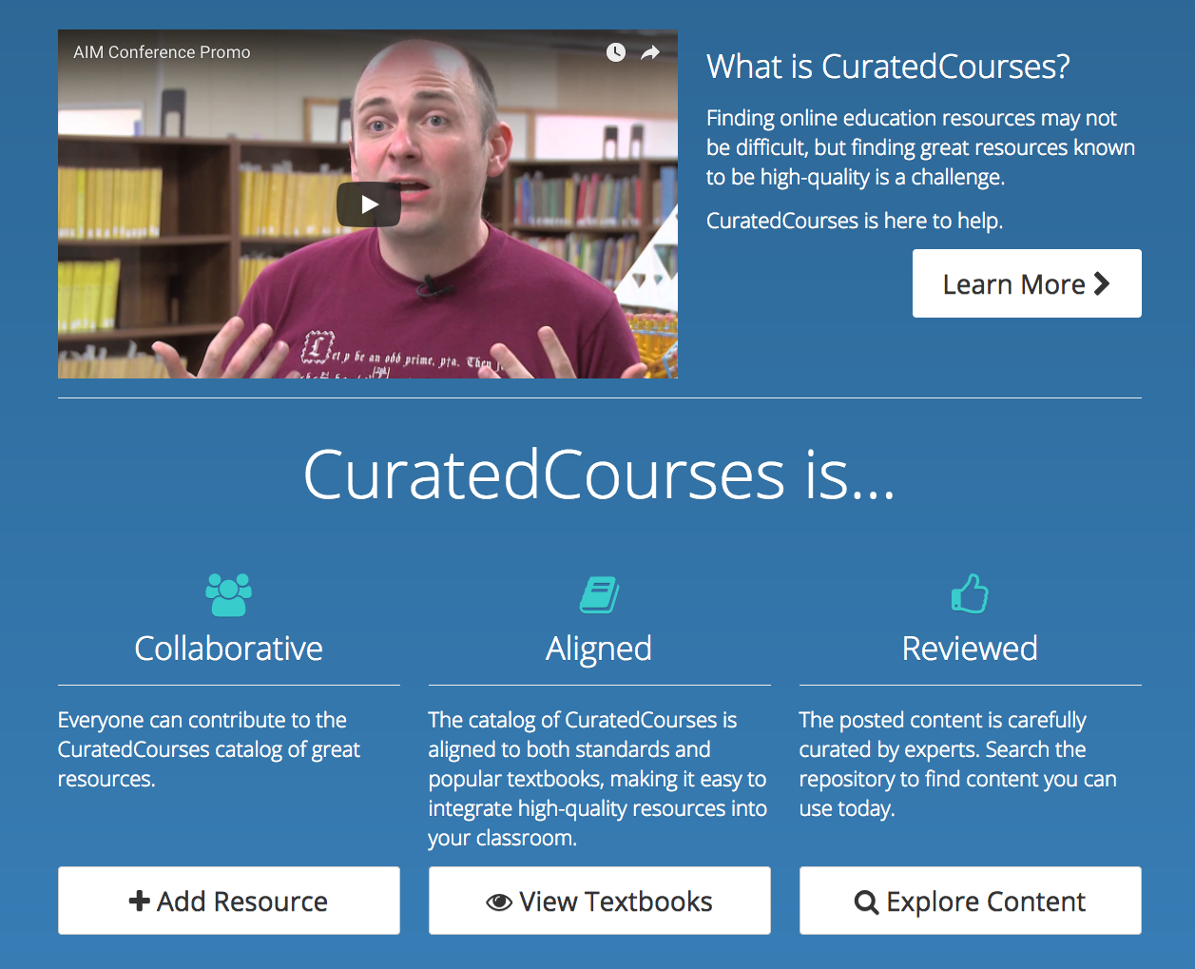
CuratedCourses Website

Slide 10
Example
Supplementary material in the margin
A resource shows up in the margin of a textbook automatically:
Notes:
Petra with David's help

Slide 11
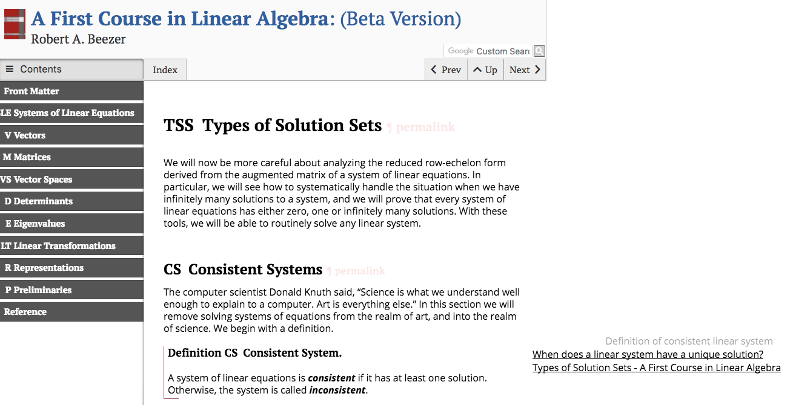
Textbook content
margin

Slide 12
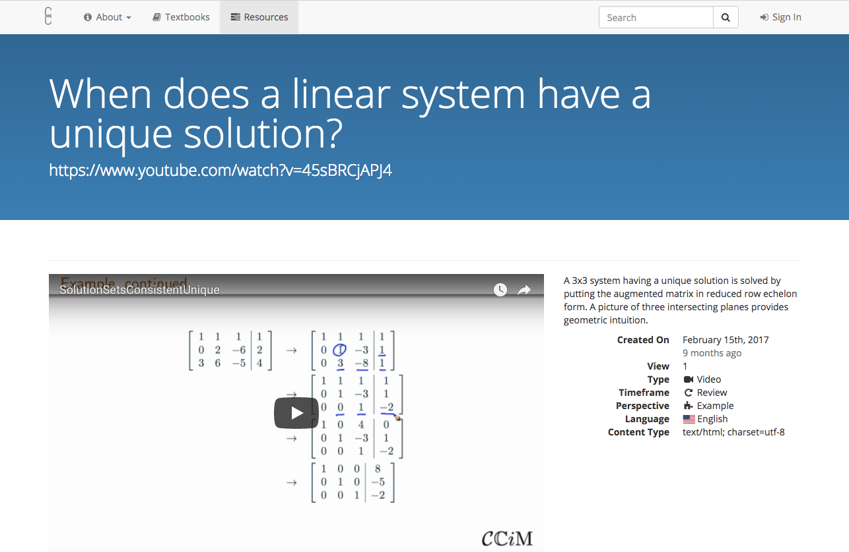

Slide 13
Resources for Creating and Using Content
Notes:
Sarah

Slide 14
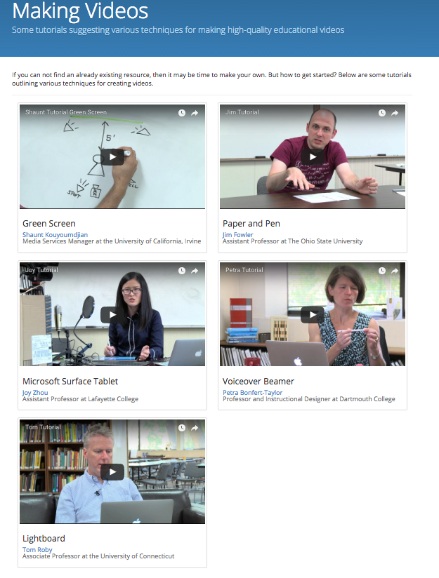
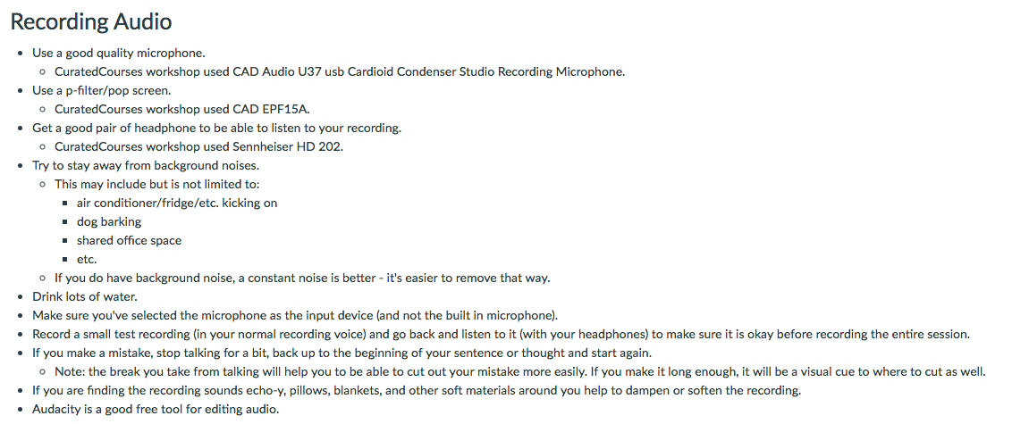
Resources: How to Design
and Produce Content (for students
to view outside class)
Guidelines and details for:
Audio/video recording
Screencasting
Green screening
Lightboard videos
Accessibility (coming soon!)
Notes:
Sarah
Maybe clarify that we have samples (eventually constituting an entire course on linear algebra) as well as information to help others create their own. Also clarify the main point: By offloading “lecture material” to view separately, classtime is freed up for active learning mentioned earlier. (Probably these types of recordings don’t count as “active learning” in and of themselves.) We don’t discuss group worksheets, clicker questions, etc.

Slide 15
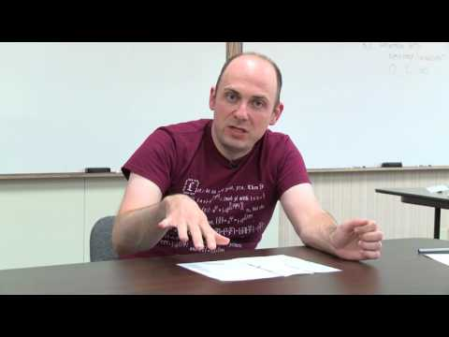
Resources: Making Videos with Paper and Pen
Jim Fowler
The Ohio State University
Notes:
Sarah

Slide 16
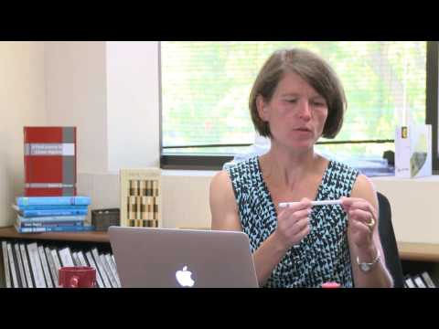
Resources: Making Screencasts I
Petra Bonfert-Taylor
Dartmouth College
Notes:
Sarah

Slide 17
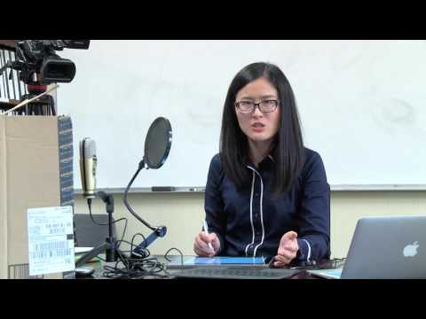
Resources: Making Screencasts II
Joy Zhou
Lafayette College
Notes:
Sarah

Slide 18
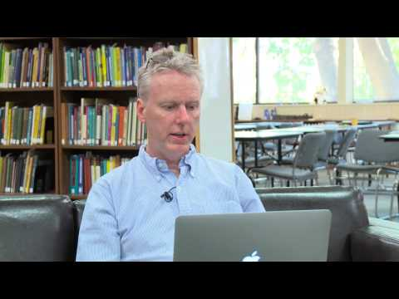
Resources: Making Lightboard Videos
Tom Roby
University of Connecticut
Notes:
Sarah

Slide 19
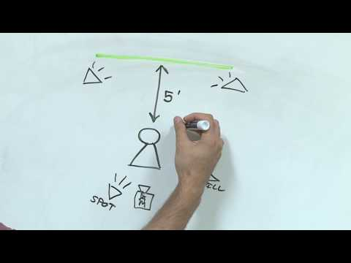
Resources: Green Screening
Shaunt Kouyoumdjian
University of California, Irvine
Notes:
Sarah

Slide 20

Resources: How to Utilize Open Educational Resources (OERs) to Support Evidence-Based Instructional Practices
JMM 2018 Minicourse:
“Flipping your Mathematics Course using
Open Educational Resources”
*Minicourse presentation slides and handouts to be available on Curated Courses website
Notes:
Sarah

Slide 21
The CuratedCourses Tagging System

Slide 22
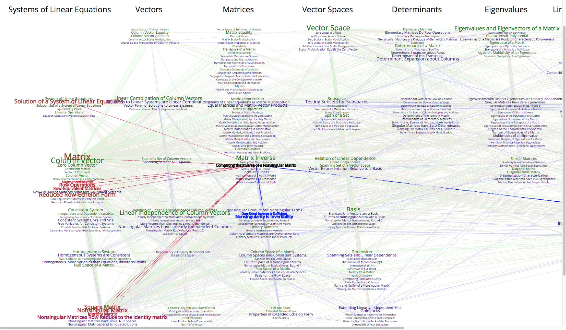
I want to learn X. What is the minimum I need to get there?

Slide 23
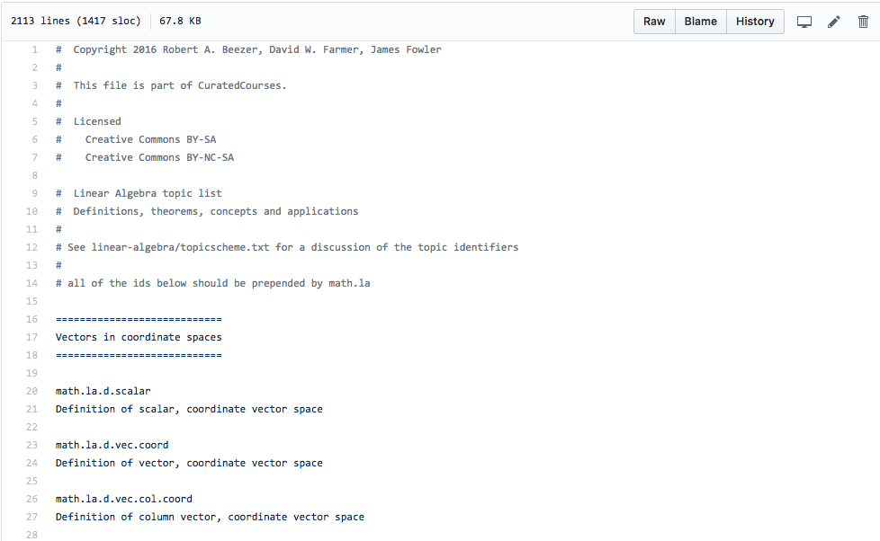
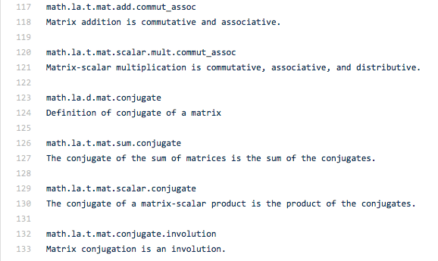
Every definition and theorem in introductory linear algebra.

Slide 24
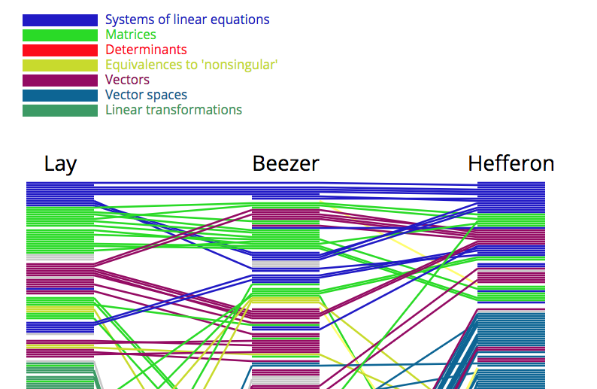
Three Books on Linear Algebra (so far).

Slide 25
Future Goals

Slide 26
CuratedCourses Beyond Linear Algebra
Expand project to
undergraduate abstract algebra
differential equations
discrete mathematics
A higher-level undergraduate mathematics course
Build and manage robust repository to host and share the OER items.
Create sustainable infrastructure: engage mathematics educators in
creating
curating
reviewing content.
Study efficacy of CuratedCourses resources in
empowering faculty to adopt active learning instructional practices
properties of OER items that make them most usable and educationally effective.
Incentivize creation of high-quality materials: View CuratedCourses as a "journal":
curation <-> refereeing
publishing resources <-> publishing a paper -> academic credit

Slide 27
Questions?

